Slide 1
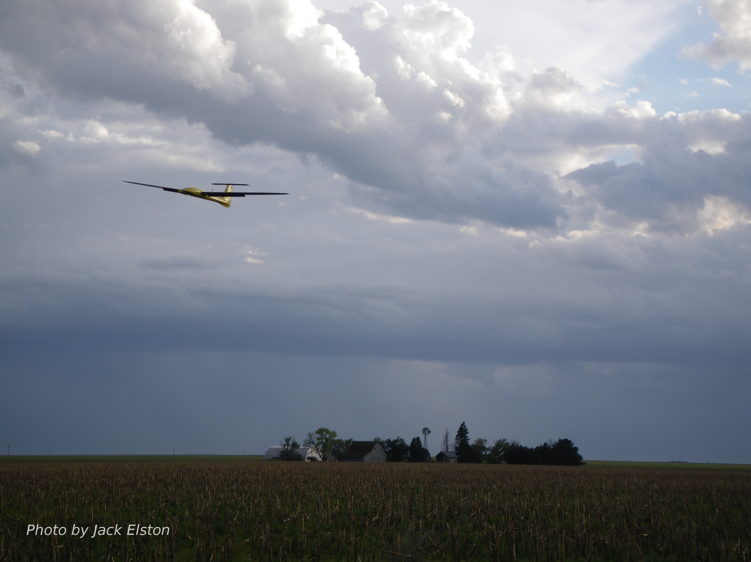
Chapter 11
Path Manager

Slide 2
Control Architecture
destination, obstacles
map
path planner
waypoints
status
path manager
path definition
tracking error
path following
airspeed, altitude,
heading,
commands
position error
autopilot
servo commands
state estimator
unmanned aircraft
wind
on-board sensors

Slide 3
Path Definition
Notes:
\noindent Waypoint path defined as ordered sequence of waypoints
\[
\mathcal{W} = \left\{ \mathbf{w}_1, \mathbf{w}_2, \dots, \mathbf{w}_N\right\}
\]
where $\mathbf{w}_i = (w_{n,i}, w_{e,i}, w_{d,i})^{\top} \in \re^3$.

Slide 4
Waypoint Switching
Two methods
b-ball around waypoint
half plane through waypoint

Slide 5
Waypoint Switching
Notes:
\noindent Given point $\mathbf{r}\in\re^3$ and normal vector $\mathbf{n}\in\re^3$,
define half plane
\[
\mathcal{H}(\mathbf{r},\mathbf{n}) \defeq \left\{ \mathbf{p}\in\re^3 : (\mathbf{p}-\mathbf{r})^{\top}\mathbf{n}\geq 0 \right\}
\]
\noindent Define unit vector pointing in direction of
line $\overline{\mathbf{w}_i\mathbf{w}_{i+1}}$ as
\[
\mathbf{q}_i \defeq \frac{\mathbf{w}_{i+1}-\mathbf{w}_{i}}{\norm{\mathbf{w}_{i+1}-\mathbf{w}_{i}}}
\]
\noindent Unit normal to the 3-D half plane that separates the line $\overline{\mathbf{w}_{i-1}\mathbf{w}_i}$ from the line $\overline{\mathbf{w}_i\mathbf{w}_{i+1}}$ is given by
\[
\mathbf{n}_i \defeq \frac{\mathbf{q}_{i-1}+\mathbf{q}_{i}}{\norm{\mathbf{q}_{i-1}+\mathbf{q}_{i}}}
\]
\noindent MAV tracks straight-line path from $\mathbf{w}_{i-1}$ to $\mathbf{w}_i$ until it enters $\mathcal{H}(\mathbf{w}_i,\mathbf{n}_i)$, at which point it will track straight-line path from $\mathbf{w}_i$ to $\mathbf{w}_{i+1}$

Slide 6
Waypoint Following

Slide 7
Waypoint Following Results

Slide 8
Fillet Transition
Transition between path segments can be smoothed by adding a fillet

Slide 9
Fillet Geometry

Slide 10
Fillet Smoothing Half Planes
Notes:
\noindent Fillet center defined as
\[
\mathbf{c} = \mathbf{w}_{i}-\left(\frac{R}{\sin\frac{\varrho}{2}}\right)\frac{\mathbf{q}_{i-1}-\mathbf{q}_{i}}{\left\|\mathbf{q}_{i-1}-\mathbf{q}_{i}\right\|}
\]
\noindent Half plane $\mathcal{H}_1$ is defined by location
\[
\mathbf{r}_1 = \mathbf{w}_i-\left(\frac{R}{\tan\frac{\varrho}{2}}\right)\mathbf{q}_{i-1}
\]
and normal vector $\mathbf{q}_{i-1}$
\noindent Half plane $\mathcal{H}_2$ is defined by location
\[
\mathbf{r}_2 = \mathbf{w}_i+\left(\frac{R}{\tan\frac{\varrho}{2}}\right)\mathbf{q}_{i}
\]
and normal vector $\mathbf{q}_{i}$

Slide 11
Waypoint Following with Fillets
Notes:
\usepackage{algorithmic,algorithm}
\newcommand{\norm}[1]{\left\|#1\right\|}
--
\begin{algorithm}
\caption{Follow Waypoints with Fillets: $(\text{flag}, \mathbf{r}, \mathbf{q}, \mathbf{c}, \rho, \lambda)=\textsf{followWppFillet}(\mathcal{W}, \mathbf{p}, R)$}
\label{alg:path-follow-waypoints-fillet}
\begin{algorithmic}[1]
\ENSURE
Waypoint path $\mathcal{W}=\{\mathbf{w}_1, \dots, \mathbf{w}_N\}$,
MAV position $\mathbf{p}=(p_n,p_e,p_d)^{\top}$, fillet radius $R$.
\REQUIRE $N\geq 3$.
\IF {New waypoint path $\mathcal{W}$ is received}
\label{alg:path-follow-waypoints-fillet-line-1}
\STATE Initialize waypoint index: $i\leftarrow 2$, and
state machine: $\text{state}\leftarrow 1$.
\label{alg:path-follow-waypoints-fillet-line-2}
\ENDIF
\label{alg:path-follow-waypoints-fillet-line-3}
\STATE $\mathbf{q}_{i-1} \leftarrow \frac{\mathbf{w}_i-\mathbf{w}_{i-1}}{\norm{\mathbf{w}_i-
\mathbf{w}_{i-1}}}$.
\label{alg:path-follow-waypoints-fillet-line-5}
\STATE $\mathbf{q}_{i} \leftarrow
\frac{\mathbf{w}_{i+1}-\mathbf{w}_i}{\norm{\mathbf{w}_{i+1}-\mathbf{w}_i}}
$.
\label{alg:path-follow-waypoints-fillet-line-6}
\STATE $\varrho \leftarrow \cos^{-1}\left(-\mathbf{q}_{i-1}^{\top}\mathbf{q}_{i}\right)$.
\label{alg:path-follow-waypoints-fillet-line-7}
\IF {$\text{state}=1$}
\label{alg:path-follow-waypoints-fillet-line-8}
\STATE $\text{flag} \leftarrow 1$
\label{alg:path-follow-waypoints-fillet-line-9}
\STATE $\mathbf{r} \leftarrow \mathbf{w}_{i-1}$
\label{alg:path-follow-waypoints-fillet-line-10}
\STATE $\mathbf{q} \leftarrow \mathbf{q}_{i-1}$
\label{alg:path-follow-waypoints-fillet-line-11}
\STATE $\mathbf{z} \leftarrow \mathbf{w}_i -
\left(\frac{R}{\tan(\varrho/2)}\right)\mathbf{q}_{i-1}$
\label{alg:path-follow-waypoints-fillet-line-12}
\IF{$\mathbf{p}\in\mathcal{H}(\mathbf{z},\mathbf{q}_{i-1})$}
\label{alg:path-follow-waypoints-fillet-line-13}
\STATE $\text{state}\leftarrow 2$
\label{alg:path-follow-waypoints-fillet-line-14}
\ENDIF
\label{alg:path-follow-waypoints-fillet-line-15}
\ELSIF {$\text{state}=2$}
\label{alg:path-follow-waypoints-fillet-line-16}
\STATE $\text{flag} \leftarrow 2$
\label{alg:path-follow-waypoints-fillet-line-17}
\STATE $\mathbf{c} \leftarrow \mathbf{w}_i - \left(\frac{R}{\sin(\varrho/2)}\right)
\frac{\mathbf{q}_{i-1}-\mathbf{q}_{i}}
{\norm{\mathbf{q}_{i-1}-\mathbf{q}_{i}}}$
\label{alg:path-follow-waypoints-fillet-line-18}
\STATE $\rho \leftarrow R$
\label{alg:path-follow-waypoints-fillet-line-19}
\STATE $\lambda \leftarrow \text{sign}(q_{i-1,n}q_{i,e} - q_{i-1,e}q_{i,n})$.
\label{alg:path-follow-waypoints-fillet-line-20}
\STATE $\mathbf{z} \leftarrow \mathbf{w}_i +
\left(\frac{R}{\tan(\varrho/2)}\right)\mathbf{q}_{i}$
\label{alg:path-follow-waypoints-fillet-line-21}
\IF{$\mathbf{p}\in\mathcal{H}(\mathbf{z},\mathbf{q}_{i})$}
\label{alg:path-follow-waypoints-fillet-line-22}
\STATE $i \leftarrow (i+1)$ until $i=N-1$.
\label{alg:path-follow-waypoints-fillet-line-23}
\STATE $\text{state}\leftarrow 1$
\label{alg:path-follow-waypoints-fillet-line-24}
\ENDIF
\label{alg:path-follow-waypoints-fillet-line-25}
\ENDIF
\RETURN $\text{flag}$, $\mathbf{r}$, $\mathbf{q}$, $\mathbf{c}$, $\rho$, $\lambda$.
\end{algorithmic}
\end{algorithm}

Slide 12
Waypoint Following with Fillets

Slide 13
Fillet Path Length
Notes:
\noindent Straight-line path length (no fillets):
\[
\abs{\mathcal{W}} \defeq \sum_{i=2}^N \norm{\mathbf{w}_i - \mathbf{w}_{i-1}}.
\]
\vspace{0.5cm}
\noindent Path length with fillets:
\[
\abs{\mathcal{W}}_F = \abs{\mathcal{W}} + \sum_{i=2}^N \left( R\varrho_i - \frac{2R}{\tan\frac{\varrho_i}{2}}\right).
\]

Slide 14
Dubins Paths
turn-straight-turn
Notes:
\noindent For vehicle with kinematics given by
\begin{align*}
\dot{p}_n &= V \cos\vartheta \\
\dot{p}_e &= V \sin\vartheta \\
\dot{\vartheta} &= u,
\end{align*}
where $V$ is constant and $u\in[-\bar{u},\bar{u}]$, time-optimal path between two different configurations consists of circular arc, followed by straight line, and concluding with another circular arc to the final configuration, where the radius of the circular arcs is $V/\bar{u}$.

Slide 15
Dubins path is defined as shortest of four cases

Slide 16
Path Length Preliminaries
Notes:
\noindent Given position $\mathbf{p}$, course $\chi$, and radius $R$, centers of right and left turning circles are given by
\begin{align*}
\mathbf{c}_r &= \mathbf{p} + R\begin{pmatrix} \cos(\chi + \frac{\pi}{2}), & \sin(\chi +
\frac{\pi}{2}), & 0 \end{pmatrix}^{\top} \\
\mathbf{c}_l &= \mathbf{p} + R\begin{pmatrix} \cos(\chi - \frac{\pi}{2}), & \sin(\chi -
\frac{\pi}{2}), & 0\end{pmatrix}^{\top}
\end{align*}

Slide 17
Path Length Preliminaries
Notes:
\noindent For clockwise circles, angular distance between
$\vartheta_1$ and $\vartheta_2$ given by
\begin{equation*}
\abs{ \vartheta_2 - \vartheta_1 }_{CW} \defeq \langle 2\pi +
\vartheta_2 - \vartheta_1 \rangle,
\end{equation*}
where
\[
\langle \varphi \rangle \defeq \varphi\mod 2\pi
\]
\noindent For counter clockwise circles,
\begin{equation*}
\abs{\vartheta_2 - \vartheta_1}_{CCW} \defeq \langle 2\pi -
\vartheta_2 + \vartheta_1 \rangle
\end{equation*}

Slide 18
Alternative Viewpoint
Notes:
\noindent For clockwise circles, angular distance between
$\vartheta_1$ and $\vartheta_2$ given by
\begin{equation*}
\abs{ \vartheta_2 - \vartheta_1 }_{CW} \defeq \langle 2\pi +
\vartheta_2 - \vartheta_1 \rangle,
\end{equation*}
where
\[
\langle \varphi \rangle \defeq \varphi\mod 2\pi
\]

Slide 19
Alternative Viewpoint
Notes:
\noindent For counter clockwise circles,
\begin{equation*}
\abs{\vartheta_2 - \vartheta_1}_{CCW} \defeq \langle 2\pi -
\vartheta_2 + \vartheta_1 \rangle
\end{equation*}

Slide 20
Dubins Case I: R-S-R
Notes:
\noindent Distance traveled along
$\mathbf{c}_{rs}$
\[
R\langle 2\pi + \langle \vartheta-\frac{\pi}{2}\rangle -
\langle\chi_s-\frac{\pi}{2}\rangle \rangle
\]
\noindent Distance traveled along $\mathbf{c}_{re}$
\[
R\langle 2\pi + \langle\chi_e-\frac{\pi}{2}\rangle -
\langle\vartheta-\frac{\pi}{2}\rangle \rangle
\]
where
\[
\vartheta = \text{atan2}(c_{ree}-c_{rse}, c_{ren}-c_{rsn})
\]
\noindent Total path length:
\begin{equation*}
L_1 = \norm{\mathbf{c}_{rs}-\mathbf{c}_{re}} + R\langle 2\pi + \langle
\vartheta-\frac{\pi}{2}\rangle - \langle\chi_s-\frac{\pi}{2}\rangle
\rangle + R\langle 2\pi + \langle\chi_e-\frac{\pi}{2}\rangle -
\langle\vartheta-\frac{\pi}{2}\rangle \rangle
\end{equation*}

Slide 21
Dubins Case II: R-S-L
Notes:
\noindent Distance traveled along
$\mathbf{c}_{rs}$
\[
R\langle 2\pi %
+ \langle \vartheta_2\rangle %
- \langle\chi_s-\frac{\pi}{2}\rangle \rangle
\]
\noindent Distance traveled along
$\mathbf{c}_{le}$
\[
R\langle 2\pi %
+ \langle\vartheta_2+\pi\rangle %
- \langle\chi_e+\frac{\pi}{2}\rangle\rangle
\]
where
\[
\vartheta_2 = \vartheta-\frac{\pi}{2}+\sin^{-1}\left(\frac{2R}{\ell}\right)
\]
\noindent Total path length:
\begin{equation*}
L_2 = \sqrt{\ell^2-4R^2} %
+ R\langle 2\pi %
+ \langle \vartheta_2\rangle %
- \langle\chi_s-\frac{\pi}{2}\rangle \rangle %
+ R\langle 2\pi %
+ \langle\vartheta_2+\pi\rangle %
- \langle\chi_e+\frac{\pi}{2}\rangle\rangle
\end{equation*}

Slide 22
Dubins Case III: L-S-R
Notes:
\noindent Distance traveled along $\mathbf{c}_{ls}$
\[
R\langle 2\pi %
+ \langle\chi_s+\frac{\pi}{2}\rangle %
- \langle \vartheta+\vartheta_2\rangle\rangle %
\]
\noindent Distance traveled along $\mathbf{c}_{re}$
\[
R\langle 2\pi %
+ \langle\chi_e-\frac{\pi}{2}\rangle
- \langle\vartheta+\vartheta_2-\pi\rangle \rangle %
\]
\noindent Total path length:
\begin{equation*}
L_3 = \sqrt{\ell^2-4R^2} %
+ R\langle 2\pi %
+ \langle\chi_s+\frac{\pi}{2}\rangle %
- \langle \vartheta+\vartheta_2\rangle\rangle %
+ R\langle 2\pi %
+ \langle\chi_e-\frac{\pi}{2}\rangle %
- \langle\vartheta+\vartheta_2-\pi\rangle \rangle %
\end{equation*}

Slide 23
Dubins Case IV: L-S-L
Notes:
\noindent Distance traveled along $\mathbf{c}_{ls}$
\[
R\langle 2\pi %
+ \langle\chi_s+\frac{\pi}{2}\rangle %
- \langle \vartheta+\frac{\pi}{2}\rangle\rangle
\]
\noindent Distance traveled along $\mathbf{c}_{le}$
\[
R\langle 2\pi %
+ \langle\vartheta+\frac{\pi}{2}\rangle %
- \langle\chi_e+\frac{\pi}{2}\rangle \rangle
\]
\noindent Total path length:
\begin{equation*}
L_4 = \norm{\mathbf{c}_{ls}-\mathbf{c}_{le}} %
+ R\langle 2\pi %
+ \langle\chi_s+\frac{\pi}{2}\rangle %
- \langle \vartheta+\frac{\pi}{2}\rangle\rangle %
+ R\langle 2\pi %
+ \langle\vartheta+\frac{\pi}{2}\rangle %
- \langle\chi_e+\frac{\pi}{2}\rangle\rangle
\end{equation*}

Slide 24
Dubins Path Half-plane Switching
Notes:
\noindent Given desired start and end \\ configurations
\begin{itemize}
\item $\pbf_s$: start location
\item $\chi_s$: start direction
\item $\pbf_e$: end location
\item $\chi_e$: end direction
\end{itemize}
--
\noindent Calculate Dubins path parameters
\begin{itemize}
\item $\cbf_s$: start circle location
\item $\lambda_s$: start circle direction
\item $\cbf_e$: end circle location
\item $\lambda_e$: end circle direction
\item $\zbf_1,\qbf_1$: half-plane $\Hcal_1$ parameters
\item $\zbf_2,\qbf_2$: half-plane $\Hcal_2$ parameters
\item $\zbf_3,\qbf_3$: half-plane $\Hcal_3$ parameters
\end{itemize}

Slide 25
Dubins Path Parameters Algorithm

Slide 26
Dubins Path Following Algorithm

Slide 27
Dubins Path Following Results

Slide 28
Need to incorporate in this next set of slides into book, and also slide deck.

Slide 33
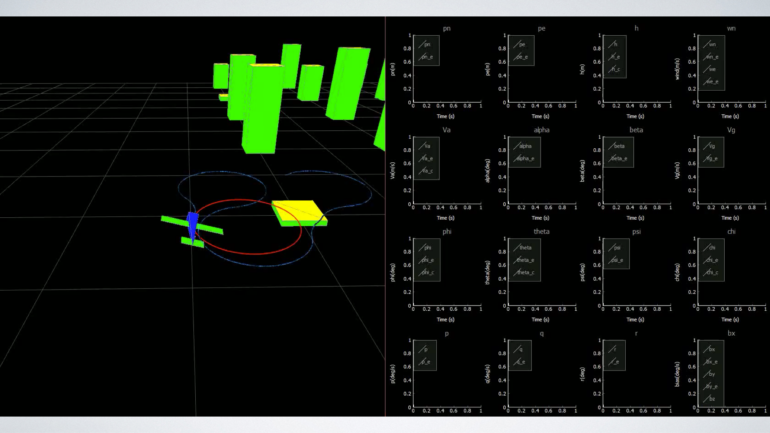

Slide 35
The best way to do this is check distance along circles and straight lines. If it is small, then just transition to the next segment.

Slide 37
Dubins Airplane Model
Adapted from: Mark Owen, Randal W. Beard, Timothy W. McLain, “Implementing Dubins Airplane Paths on Fixed-wing UAVs,” Handbook of Unmanned Aerial Vehicles, ed. Kimon P. Valavanis, George J. Vachtsevanos, Springer Verlag, Section XII, Chapter 68, p. 1677-1702, 2014.
horizontal component
of airspeed vector
Flight path projected onto ground
Notes:
\noindent {\bf Dubins Airplane model:}
\begin{align*}
\dot{r}_n &= V\cos\psi \cos\gamma^c \\
\dot{r}_e &= V\sin\psi \cos\gamma^c \\
\dot{r}_d &= -V\sin\gamma^c \\
\dot{\psi} &= \frac{g}{V}\tan\phi^c
\end{align*}
\noindent Where the commanded flight path angle $\gamma^c$ and the commanded roll angle $\phi^c$ are constrained by
\begin{align*}
|\phi^c| &\leq \bar{\phi} \\
|\gamma^c| &\leq \bar{\gamma}.
\end{align*}

Slide 38
3D Vector Field Path Following
Adapted from: V. M. Goncalves, L. C. A. Pimenta, C. A. Maia, B. C. O. Durtra, G. A. S. Pereira, B. C. O. Dutra, and G. A. S. Pereira, “Vector Fields for Robot Navigation Along Time-Varying Curves in n-Dimensions,” IEEE Transactions on Robotics, vol. 26, pp. 647–659, Aug 2010.
Notes:
\noindent The path is specified as the intersection of two 2D manifolds given by
\begin{align*}
\alpha_1(\mathbf{r})&=0 \\
\alpha_2(\mathbf{r})&=0
\end{align*}
$\mathbf{r}\in\mathbb{R}^3$.
Define the composite function
\[
W(\mathbf{r}) = \frac{1}{2}\alpha_1^2(\mathbf{r}) + \frac{1}{2}\alpha_2^2(\mathbf{r}),
\]
Note that the gradient
\[
\frac{\partial W}{\partial \mathbf{r}} = \alpha_1(\mathbf{r})\frac{\partial \alpha_1}{\partial \mathbf{r}}(\mathbf{r}) + \alpha_2(\mathbf{r})\frac{\partial \alpha_2}{\partial \mathbf{r}}(\mathbf{r}).
\]
points away from the path.

Slide 39
3D Vector Field Path Following
Notes:
\noindent The desired velocity vector can be chosen as
\[
\mathbf{u}' = \underbrace{- K_1 \frac{\partial W}{\partial \mathbf{r}}}_{\text{velocity directed toward the path}} + \underbrace{K_2 \frac{\partial \alpha_1}{\partial \mathbf{r}} \times \frac{\partial \alpha_2}{\partial \mathbf{r}}}_{\text{velocity directed along the path}}
\]
where $K_1>0$ and $K_2$ are symmetric tuning matrices, and the definiteness of $K_2$ determines the direction of travel along the path.
\vspace{1cm}
\noindent Since $\mathbf{u}'$ may not equal $V_a$, normalize to get
\[
\mathbf{u} = V_a\frac{\mathbf{u}'}{\|\mathbf{u}'\|}.
\]

Slide 40
3D Vector Field Path Following
Notes:
\noindent Setting the NED components of the velocity of the Dubins airplane model to $\mathbf{u} = (u_1, u_2, u_3)^\top$ gives
\begin{align*}
V\cos\psi^d \cos\gamma^c &= u_1\\
V\sin\psi^d \cos\gamma^c &= u_2 \\
-V\sin\gamma^c &= u_3.
\end{align*}
Solving for $\gamma^c$, and $\psi^d$ results in
\begin{align*}
\gamma^c &= -\text{sat}_{\bar{\gamma}}\left[\sin^{-1}\left(\frac{u_3}{V}\right) \right] \\
\psi^d &= \text{atan2}(u_2,u_1).
\end{align*}
Assuming the inner-loop lateral-directional dynamics are accurately modeled by the coordinated-turn equation, the commanded roll angle is
\[
\phi^c = \text{sat}_{\bar{\phi}}\left[k_{\phi}(\psi^d - \psi)\right],
\]
where $k_\phi$ is a positive constant.

Slide 41
3D Vector Field – Straight Line path
Notes:
The straight line path is given by
\[
\mathcal{P}_{\text{line}}(\mathbf{c}_\ell,\psi_\ell,\gamma_\ell) = \left\{
\mathbf{r}\in\mathbb{R}^3 : \mathbf{r} = \mathbf{c}_\ell +
\sigma\mathbf{q}_\ell, \sigma\in\mathbb{R} \right\},
\]
where
\[
\mathbf{q}_\ell = \begin{pmatrix} q_n \\ q_e \\ q_d \end{pmatrix} = \begin{pmatrix} \cos\psi_\ell\cos\gamma_\ell \\ \sin\psi_\ell\cos\gamma_\ell \\ -\sin\gamma_\ell \end{pmatrix}.
\]
Define
\begin{align*}
\mathbf{n}_{\text{lon}} &= \begin{pmatrix}-\sin\psi_\ell \\ \cos\psi_\ell \\ 0 \end{pmatrix} \\
\mathbf{n}_{\text{lat}} &= \mathbf{n}_{\text{lon}} \times \mathbf{q}_\ell = \begin{pmatrix}-\cos\psi_\ell\sin\gamma_\ell \\ -\sin\psi_\ell\sin\gamma_\ell \\ -\cos\gamma_\ell \end{pmatrix},
\end{align*}
to get
\begin{align*}
\alpha_{\text{lon}}(\mathbf{r}) &= \mathbf{n}_{\text{lon}}^\top (\mathbf{r}-\mathbf{c}_\ell) = 0 \\
\alpha_{\text{lat}}(\mathbf{r}) &= \mathbf{n}_{\text{lat}}^\top (\mathbf{r}-\mathbf{c}_\ell) = 0.
\end{align*}

Slide 42
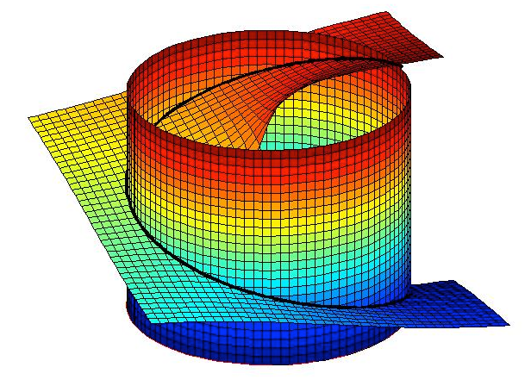
3D Vector Field – Helical Path
Notes:
\noindent A helical path is then defined as
\[
\mathcal{P}_{\text{helix}}(\mathbf{c}_h, \psi_h, \lambda_h, R_h, \gamma_h) = \{ \mathbf{r}\in\mathbb{R}^3: \alpha_{\text{cyl}}(\mathbf{r})=0 \text{~and~} \alpha_{\text{pl}}(\mathbf{r})=0 \}.
\]
where
\begin{align*}
\alpha_{\text{cyl}}(\mathbf{r}) &= \left(\frac{r_n-c_n}{R_h}\right)^2+\left(\frac{r_e-c_e}{R_h}\right)^2 - 1 \\
\alpha_{\text{pl}}(\mathbf{r}) &= \left(\frac{r_d-c_d}{R_h}\right) + \frac{\tan\gamma_h}{\lambda_h}\left(\tan^{-1}\left(\frac{r_e-c_e}{r_n-c_n}\right)-\psi_h\right)
\end{align*}
where the initial position along the helix is
\[
\mathbf{r}(0) = \mathbf{c}_h + \begin{pmatrix} R_h\cos\psi_h \\ R_h\sin\psi_h \\ 0 \end{pmatrix}.
\]
$\mathbf{c}_h$ is the center of the helix, $R_h$ is the radius, $\gamma_h$ is the climb angle.

Slide 43
Dubins Airplane Paths
Notes:
Given the start configuration $\mathbf{z}_s = (z_{ns}, z_{es}, z_{ds},\psi_s)^\top$ and the end configuration $\mathbf{z}_e = (z_{ne}, z_{ee}, z_{de}, \psi_e)^\top$ and the turn radius $R$, let $L_{\text{car}}(R,\mathbf{z}_s,\mathbf{z}_e)$ be the length of the Dubins car path.
Recall that $\bar{\gamma}$ is the limit of the fight path angle. There are three possible cases for the commanded altitude gain:
\vspace{0.5cm}
\par\noindent{\bf Low Altitude:}
\[
|z_{de}-z_{ds}| \leq L_{\text{car}}(R_{\min}) \tan\bar{\gamma},
\]
i.e., the altitude gain can be achieved by following the Dubins car path with a flight path angle $|\gamma^c|\leq\bar{\gamma}$.
\vspace{0.5cm}
\par\noindent{\bf High Altitude:}
\[
|z_{de}-z_{ds}| > \left[L_{\text{car}}(R_{\min}) + 2\pi R_{\min}\right]\tan\bar{\gamma}.
\]
i.e., the altitude gain is larger than following the Dubins car path plus one orbit, at flight path angle $\bar{\gamma}$.
\vspace{0.5cm}
\par\noindent{\bf Medium Altitude:}
\[
L_{\text{car}}(R_{\min}) \tan\bar{\gamma} < |z_{de}-z_{ds}| \leq \left[L_{\text{car}}(R_{\min}) + 2\pi R_{\min}\right]\tan\bar{\gamma}.
\]

Slide 44
Low Altitude Dubins Airplane Paths
Notes:
\begin{align*}
\gamma^{\ast} &= \tan^{-1}\left(\frac{|z_{de}-z_{ds}|}{L_{\text{car}}(R_{\min})}\right) \\
R^\ast &= R_{\min} \\
L_{\text{air}}(R_{\min},\gamma^{\ast}) &= \frac{L_{\text{car}}(R_{\min})}{\cos\gamma^{\ast}}.
\end{align*}

Slide 45
High Altitude Dubins Airplane Paths
Notes:
Find smallest integer $k$ such that
\begin{multline*}
\left(L_{\text{car}}(R_{\min})+ 2\pi k R_{\min}\right) \tan\bar{\gamma} \\
\leq |z_{de}-z_{ds}| < \\ \left(L_{\text{car}}(R_{\min})+ 2\pi (k+1) R_{\min}\right)\tan\bar{\gamma}.
\end{multline*}
Increase the radius $R^{\ast}$ so that
\[
\left(L_{\text{car}}(R^{\ast})+ 2\pi k R^{\ast}\right)\tan\bar{\gamma} = |z_{de}-z_{ds}|.
\]
The resulting path is
\[
L_{\text{air}}(R^{\ast},\bar{\gamma}) = \frac{L_{\text{car}}(R^{\ast})}{\cos\bar{\gamma}}.
\]

Slide 46
Medium Altitude Dubins Airplane Paths
Key idea: Add an intermediate helix along the path.
Could add intermediate helix at start, end, or in the middle of path.
Notes:
\begin{align*}
\gamma^{\ast} &= \tan^{-1}\left(\frac{|z_{de}-z_{ds}|}{L_{\text{car}}(R_{\min})}\right) \\
R^\ast &= R_{\min} \\
L_{\text{air}}(R_{\min},\gamma^{\ast}) &= \frac{L_{\text{car}}(R_{\min})}{\cos\gamma^{\ast}}.
\end{align*}

Slide 47
Medium Altitude Dubins Airplane Paths
Notes:
\begin{align*}
\gamma^{\ast} &= \tan^{-1}\left(\frac{|z_{de}-z_{ds}|}{L_{\text{car}}(R_{\min})}\right) \\
R^\ast &= R_{\min} \\
L_{\text{air}}(R_{\min},\gamma^{\ast}) &= \frac{L_{\text{car}}(R_{\min})}{\cos\gamma^{\ast}}.
\end{align*}

